Slide 1
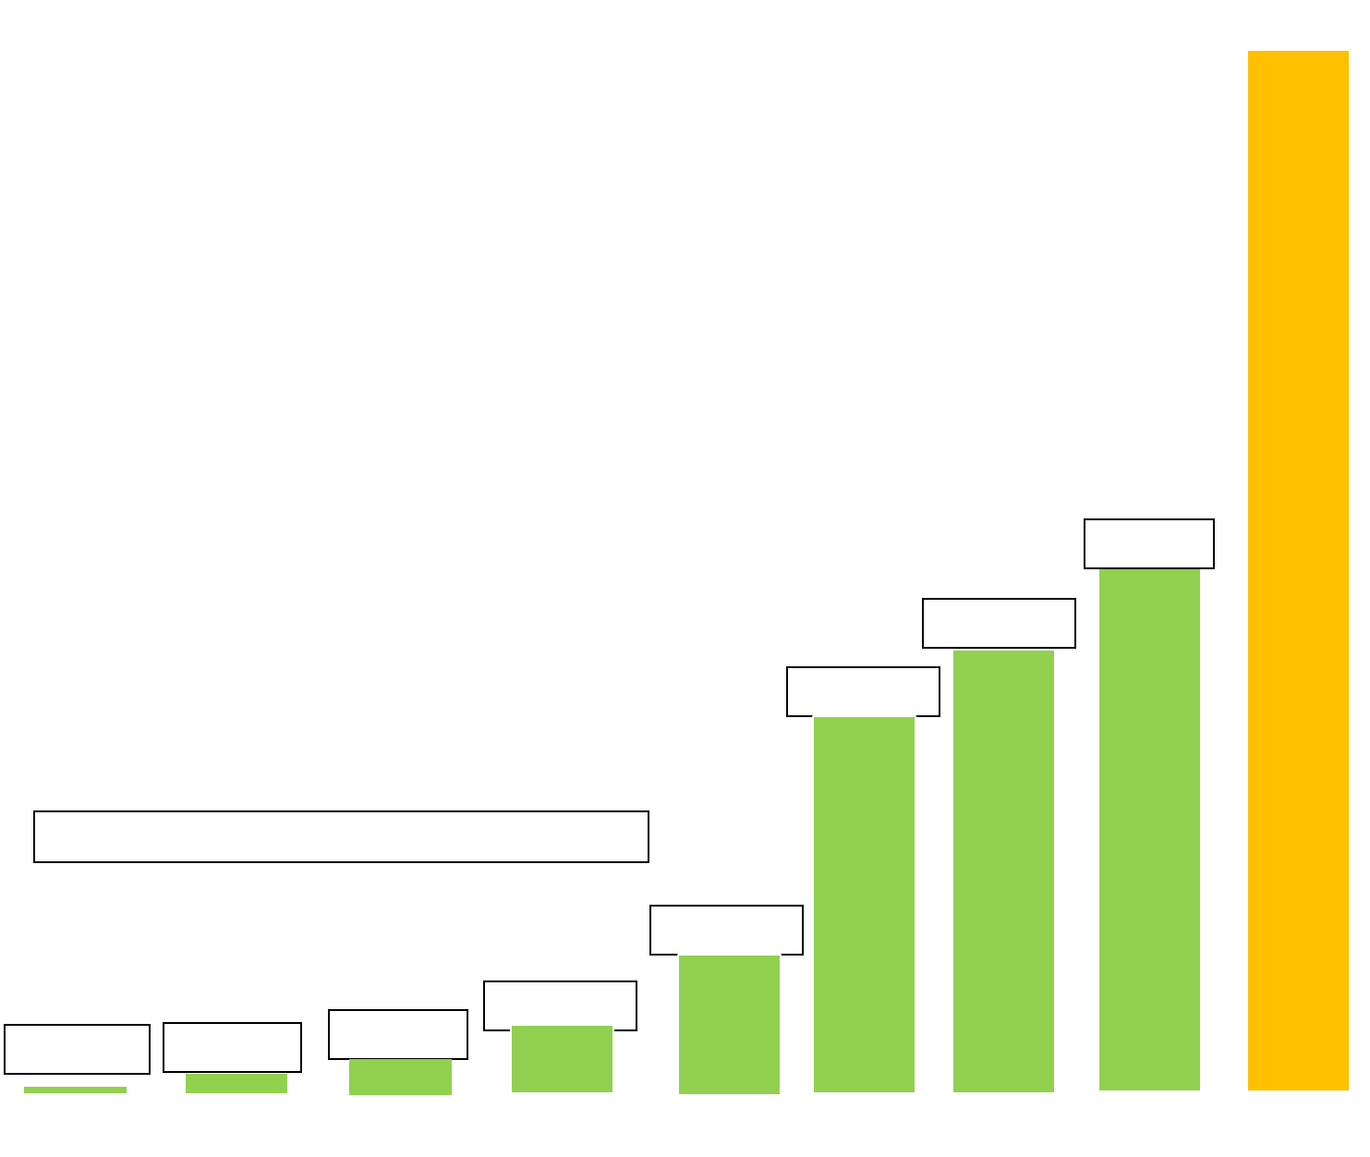
Amazon S3 Growth
Peak Requests:
1.000,000+ per second
Biggest number of Price Reductions
Introduction of new Platform and Database Services

